Slide 1
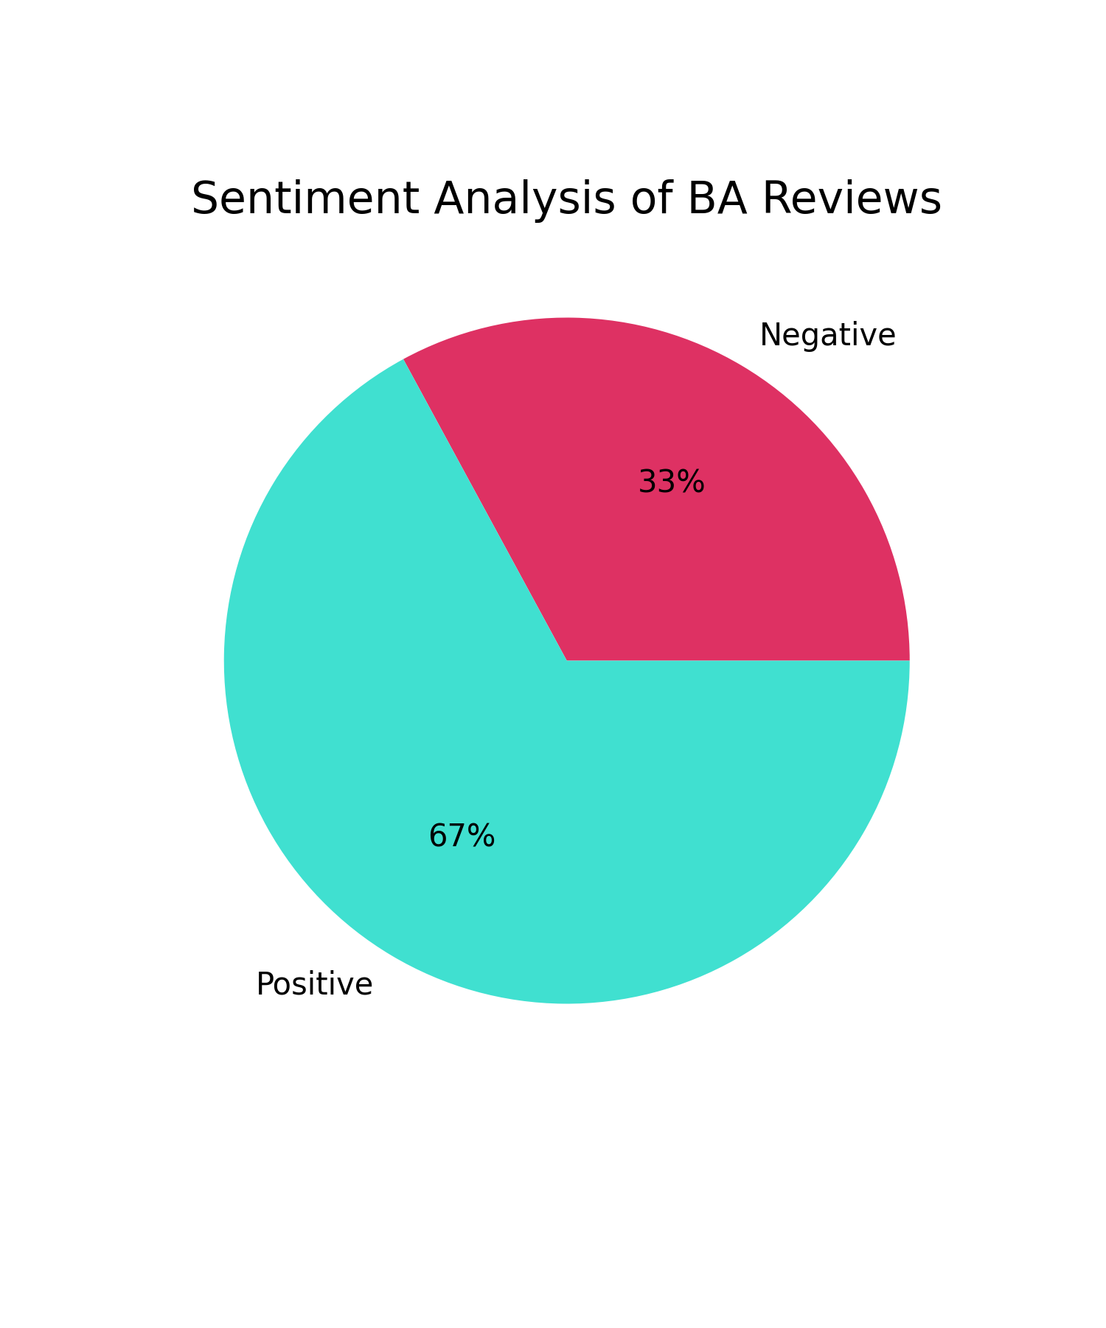
Summary of Task 1
Problem:
British Airways wants to examine their customers about their services on board and analyse their reviews on Skytrax wich is a web platform where clients write their reviews and feedback about airline comapanies.
Exploratory Data Analysis:
BA demands to examine these reviews about their services on the platform. We scraped around 3542 text reviews to perform sentiment analysis about customers feedback. After data gathering, texts are then cleaned and preprocessed for further analysis.
Insights:
Around 67% of clients are in general satisified with the services provided by the company.
Around 33% of customers feel negative about some of the services of the company.
Most frequent words in positive reviews are: flight, plane, food, staff, etc.
Most frequent words in negative reviews are: seat, service, crew, time,etc.

